Slide 1
Electric Coop 101
Austin J. Slater, Jr.
austinjslaterjr@gmail.com
(301) 399-2510

Slide 2
A more diverse and sustainable future…
Electric cooperatives electrified rural America 85 years ago. Today, we are providing a path toward a more diverse and sustainable future, including the energy for electrifying vehicles and other elements of our modern infrastructure.
America's Electric Cooperatives: Energy is Us – YouTube

Slide 3
What is an Electric Cooperative?

Slide 4
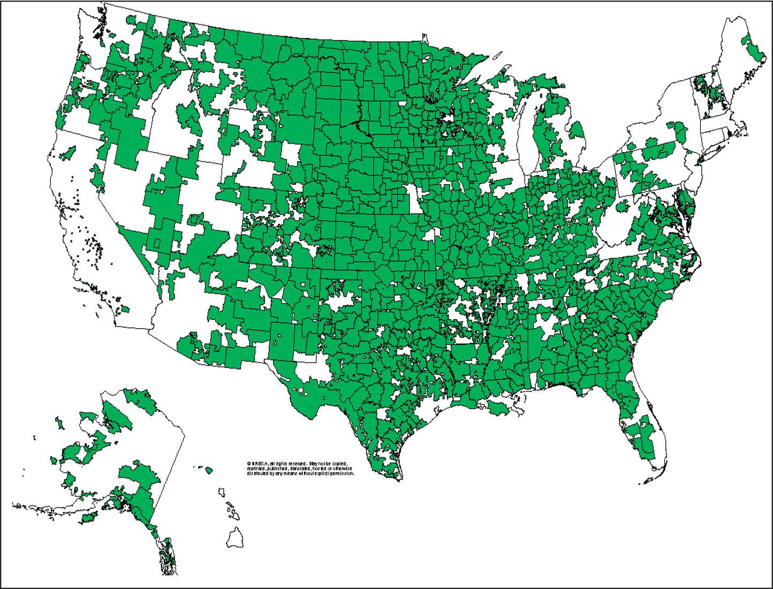
US Electric Cooperatives Today:
Serve
  42 million people
  60% of land mass
  13% of the population
  42% (2.6 million miles) of US power lines
832 Distribution and 65 Generation & Transmission Coops
Power over 21.5 million businesses, homes, schools and farms in 48 states (ex. CT & MA).
More than 250 co-ops deployed or are planning to deploy broadband
In 2021 returned more than $1.4 billion in capital credits to their consumer-members.

Slide 5

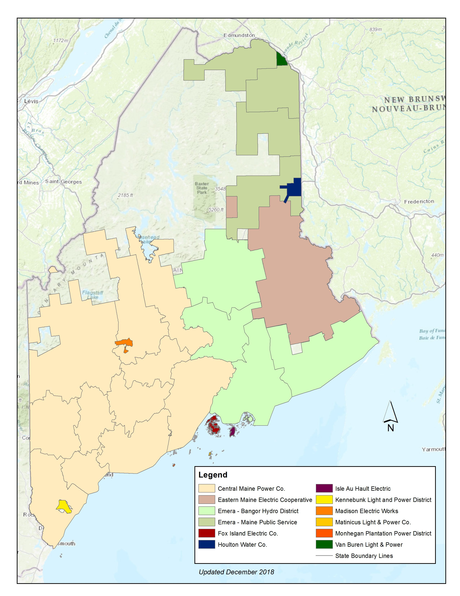

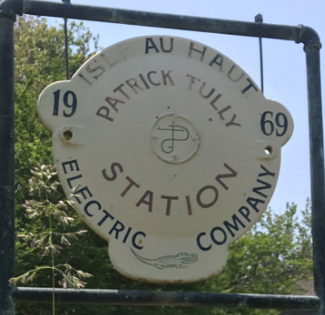
Maine’s Electric Cooperatives:
  Calais, ME
  12,864 consumers
  Founded 1940
  Vinalhaven, ME
  2,091 consumers
  Founded 1975
  Isle Au Haut, ME
  128 consumers
  Founded 1983

Slide 6

Density and Costs (per mile of line)
Municipal Utilities
(48)
Investor- Owned Utilities
(34)
Electric Cooperatives
(7.4)
0
10
20
30
40
50

Slide 7
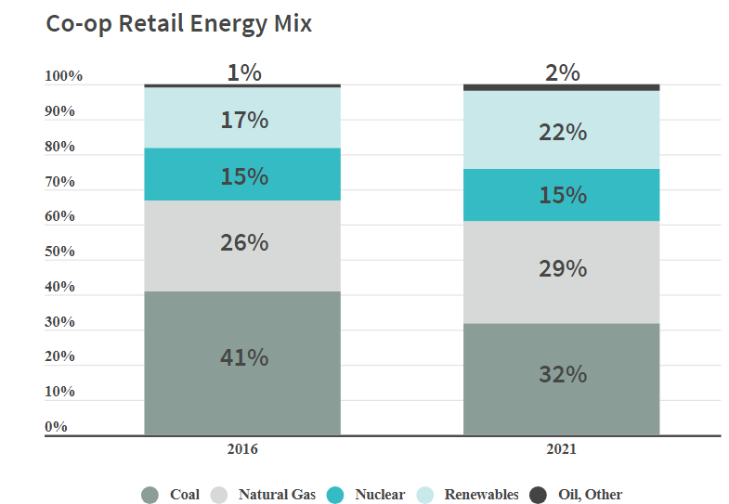
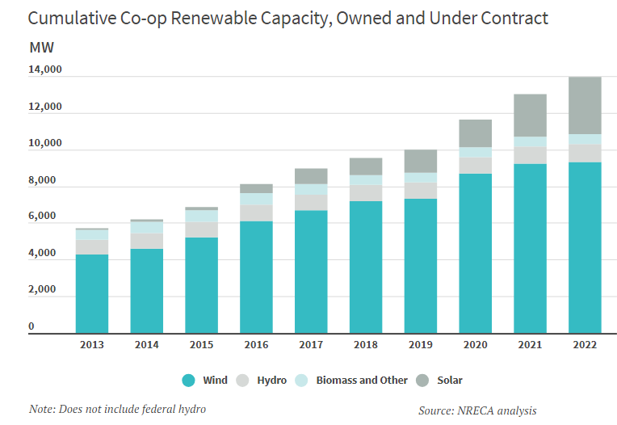
Industry Transition (43% generated / 57% purchased)

Slide 8
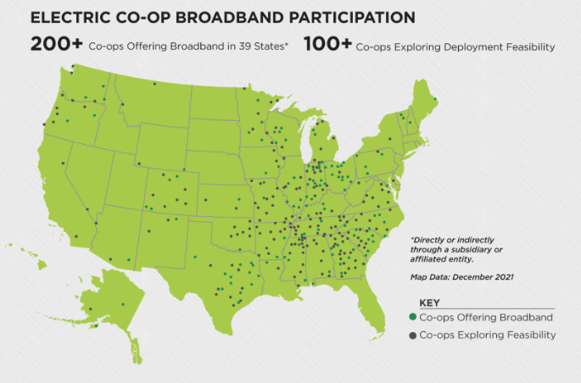
Cooperative Technology
Innovation Hubs
Closing the Digital Divide
Smart Meters: Electric cooperatives lead the industry in smart meter deployment, with a 81% use of AMI meters, compared to 67% for the rest of the industry.
Energy Storage: Cooperatives have developed more than 75 energy storage projects, ranging from residential batteries to large utility-scale projects paired with renewable generation. Storage is an important element of microgrids, including on military installations.
Carbon Capture: Electric cooperatives are partners in innovative carbon capture technology research projects.
Electric vehicle charging networks.
New cybersecurity tools.
Rural microgrids.
Clean energy research, development and deployment
Enhance grid resiliency and modernization efforts.

Slide 9

When a natural disaster is declared by the President consumer-owned utilities qualify for FEMA reimbursement.
FEMA provides 75% of qualifying costs, some states provide the remaining 25%.
IOU’s do not enjoy this privilege.
FEMA processes should be streamlined and clear to ensure consistency and efficiency for electric cooperatives.

Slide 10
Electric Cooperative Principles

Slide 11
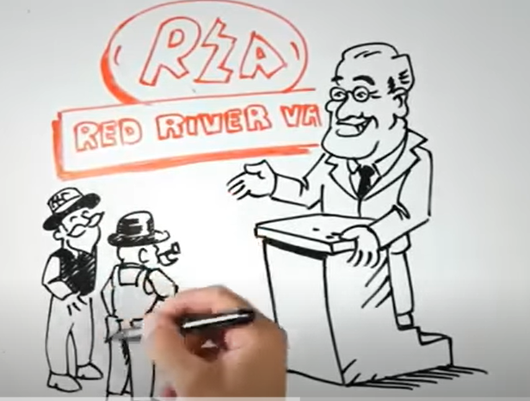
The Electric Co-op Story Video
The Electric Cooperative Story - YouTube

Slide 12
What Is the Electric Cooperative Business Model?
Members First
One Member /One Vote
Ownership
Democratic Control
Self-Help
Contribution of Capital
Self-Reliance
Seven Cooperative Principles

Slide 13

Seven Cooperative Principles
Voluntary and open membership
Democratic member control
Members’ economic participation
Notes:
Explain each of the seven cooperative principles.
Consumer cooperative businesses are special not only because are they owned by the consumers they serve, but because they are guided by a set of principles that reflect the best interests of the consumers.
Voluntary and Open Membership — Cooperatives are voluntary organizations, open to all persons able to use their services and willing to accept the responsibilities of membership, without gender, social, racial, political, or religious discrimination.
Democratic Member Control — Cooperatives are democratic organizations controlled by their members, who actively participate in setting policies and making decisions. The elected representatives are accountable to the membership. In primary cooperatives, members have equal voting rights (one member, one vote) and cooperatives at other levels are organized in a democratic manner.
Members’ Economic Participation — Members contribute equitably to, and democratically control, the capital of their cooperative. At least part of that capital is usually the common property of the cooperative. Members usually receive limited compensation, if any, on capital subscribed as a condition of membership. Members allocate surplus for any or all of the following purposes: developing the cooperative, possibly by setting up reserves, at least part of which would be indivisible; benefiting members in proportion to their transactions with the cooperative; and supporting other activities approved by the membership.

Slide 14
Seven Cooperative Principles
Education, training, and information
Autonomy and independence
Cooperation among cooperatives
Concern for community
Notes:
Explain each of the seven cooperative principles.
Principles (cont’d):
Autonomy and Independence — Cooperatives are autonomous, self-help organizations controlled by their members. If they enter into agreements with other organizations, including governments, or raise capital from external sources, they do so on terms that ensure democratic control by their members and maintain their cooperative autonomy.
Education, Training, and Information — Cooperatives provide education and training for their members, elected representatives, managers, and employees so they can contribute effectively to the development of their cooperatives. They inform the general public, particularly young people and opinion leaders, about the nature and benefits of cooperation.
Cooperation Among Cooperatives — Cooperatives serve their members most effectively and strengthen the cooperative movement by working together through local, national, regional, and international structures.
Concern for Community — While focusing on member needs, cooperatives work for the sustainable development of their communities through policies accepted by their members.

Slide 15
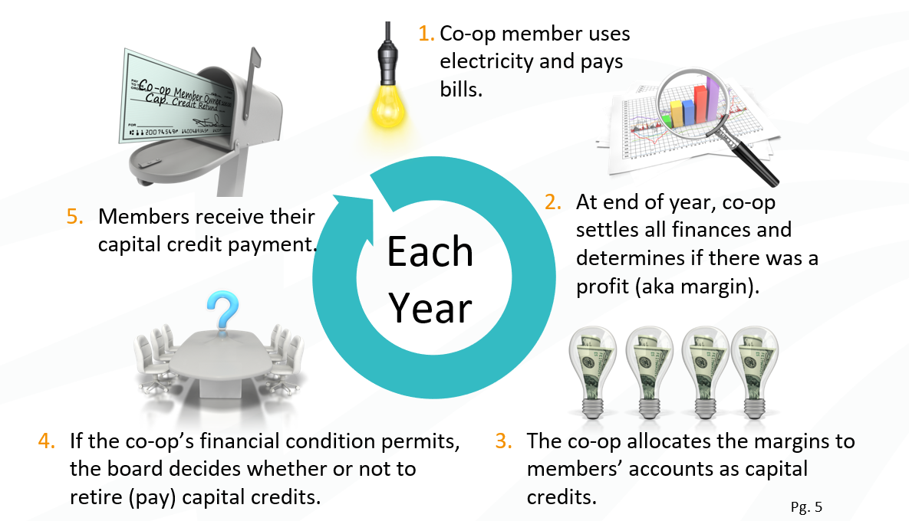
What are Capital Credits?

Slide 16










Cooperative Owned Service Organizations

Slide 17
Maintaining Income Tax Exemption
Under IRS Code - Section 501(c) (12)
Co-ops must meet three tests:
  Engage in “like organization” business activities
  Operate under cooperative principles
    Democratic member control
    Subordination of capital
    Operation at cost
  Meet the 85/15 test
  And must file an annual
  information return
  IRS Form 990

Slide 18
Other Taxes
Cooperatives pay state and local property taxes
Most cooperatives are exempt from sales taxes
Cooperatives do not pay state income tax
Cooperatives must pay all forms of wage related taxes
State regulated cooperatives pay some form of assessment or tax to their state regulator

Slide 19








Regulatory Authorities

Slide 20
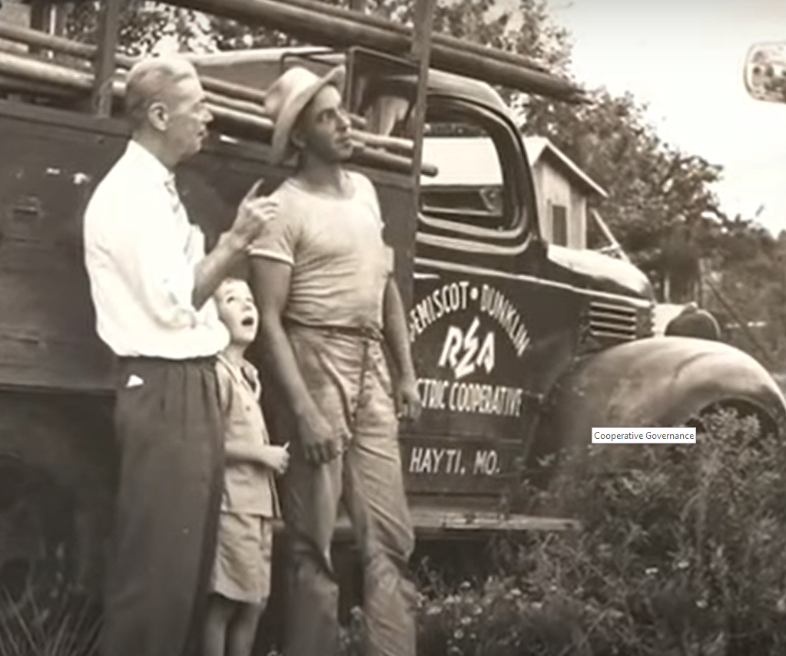
Democratizing the American Dream
Cooperative Purpose – YouTube

Slide 21
Cooperative Governance

Slide 22
State Laws Enabling Co-ops to Exist
Most States adopted Enabling Legislation
In Maine
  Maine Municipal and Rural Electrification Cooperative Agency Act
  Outlines the rules and regulations for the formation and operation of electric cooperatives in Maine.
  The act is contained in Title 13, Chapter 85 of the Maine State Legislature.
  The act defines a cooperative as “an association organized under this chapter for the purpose of providing electric service to its members at cost”
  It also outlines the procedures for forming a cooperative, including the requirements for articles of incorporation, bylaws, and membership.

Slide 23
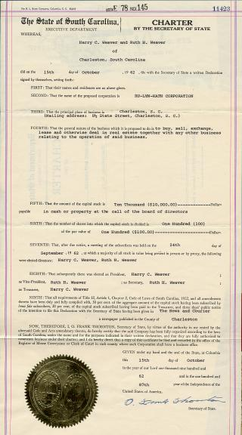
Articles of Incorporation
Are a contract between the state and the corporation
Grant the right of the corporation to exist

Slide 24
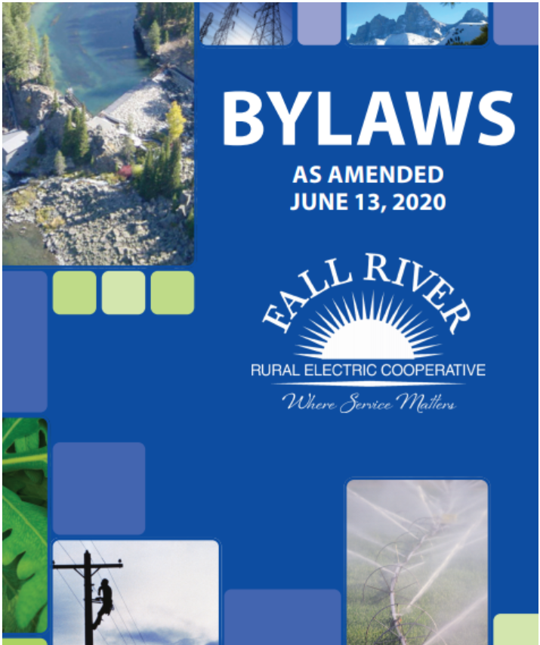
Knowing, Reviewing, and Honoring the Bylaws
A contract between the corporation and the members
Specific to each co-op
Empowers board and principal officers
May determine the structure and size of board
Describes how voting is handled
Explain conditions for mergers or consolidation

Slide 25
Bylaws (Continued)
Conditions and requirements for membership
Requirements for a quorum at board and member meetings
Responsibilities of board officers

Slide 26
Director Powers, Duties, and Rights

Slide 27


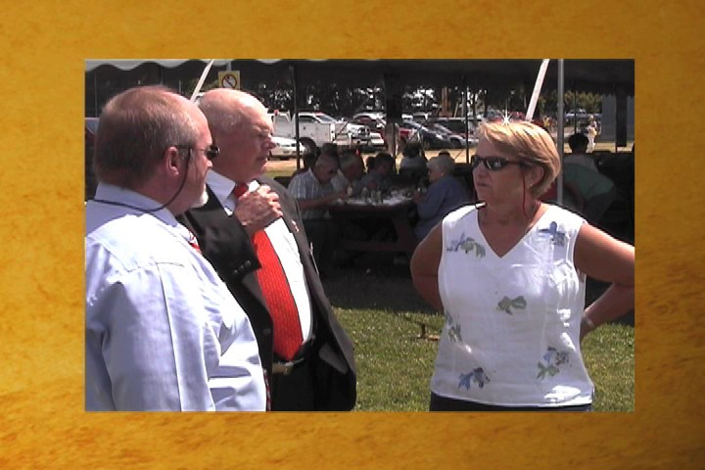
What is the Role of the Board?
Fiduciary
Regulator
Advocate
Oversight Responsibility
Setting Rates
Represent the Membership

Slide 28

Board Power
All corporate powers reside in the board, except those reserved for the members
With power comes responsibility – and potential liability

Slide 29
The Board’s Power and Responsibility
Understand the corporation’s operations
Evaluate the CEO’s performance
Provide strategic guidance
Work with the CEO in developing and evaluating corporate objectives and strategic plans
Challenge, support, and compensate the CEO as warranted
Determine the corporate mission
Approve policies

Slide 30
Roles: The Board and The Members
Board
Members
Provide oversight
Allocate resources
Decide what lines of business to be in (consistent with state law)
Hire a chief executive
Hire and engage the auditor
Hire and engage the corporate attorney
Meet monthly
Elect directors
Change the bylaws
Vote on any proposed merger, consolidation, sale, or dissolution of the cooperative
Petition for special meetings
Petition for removal of individual directors
Amend the articles of incorporation

Slide 31

Fiduciary Responsibility of a Cooperative Director
The board must prudently represent the interests of the members as a group
Directors can act on the membership’s behalf only as a group ― not as individual directors
Three Duties
  Care
  Obedience
  Loyalty

Slide 32

Director Rights
CEO access
Books and records
Notice of meetings
Minutes
Outside advice
Hear prudent judgment
of others
Reliance on others
  Cooperatives attorney
  Auditor
  Experts

Slide 33
In Closing…

Slide 34
Co-ops Are Local Energy and Technology Partners
Built by and belong to the communities they serve.
Led by members from the community
Uniquely suited to meet local needs.
Local, member-driven structure
Enjoy the highest consumer-satisfaction scores within the electric industry, according to J.D. Power
Scored higher than all other energy utilities, according to the American Customer Satisfaction Index in 2022-2023.

Slide 35
Coops are perfectly aligned with the best interest of the Members
Members
(owner-customers)
Board of Directors
(elected from the membership)
CEO

Slide 36
Q & A

